Slide 1
CPR E 281: Digital Logic
Md Maruf Ahamed
Office: 307 Durham Center
Phone: (515) 294-6323
Email: maruf@iastate.edu

Slide 2
02 – Number Systems
  Number systems
  Binary number system
  Decimal to Binary number conversion
  Octal System
  Binary to Octal number Conversion
  Hexadecimal System
  Hexadecimal to Decimal number conversion
  Binary to Hexadecimal number conversion
  Decimal to Hexadecimal Conversion

Slide 3
Administrative Stuff
  Homework: HW #00 due on Sunday @ 11:59 PM
  Quiz: Quiz #01 next week
  Recitation: Recitation #01 next week
  Lab: Lab # 01 next week

Slide 4
Number Systems
[http://www.chompchomp.com/images/irregular011.jpg ]

Slide 5
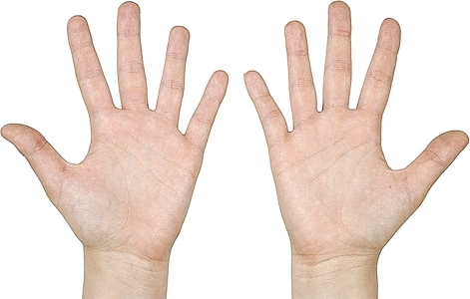
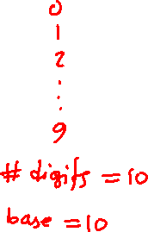
The Decimal System
[http://www.chompchomp.com/images/irregular011.jpg ]

Slide 6

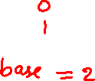
The Binary System
[ http://divaprojections.blogspot.com/2011/11/alien.html]

Slide 7

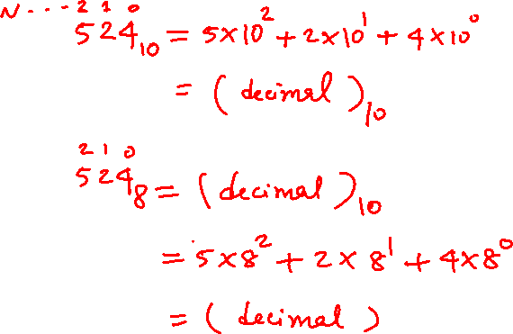
Number Systems: Positional Representations

Slide 8
Number Systems
n-th digit
(most significant)
0-th digit
(least significant)

Slide 9

Number Systems
base
power
n-th digit
(most significant)
0-th digit
(least significant)

Slide 10

The Decimal System

Slide 11



The Decimal System

Slide 12
Another Way to Look at This
5
2
4

Slide 13
Another Way to Look at This
10²
10¹
10⁰
5
2
4

Slide 14
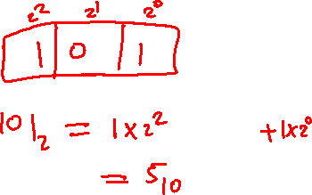
Another Way to Look at This
10²
10¹
10⁰
labels
boxes
5
2
4
Each box can contain only one digit and has only one label. From right
to left, the labels are increasing powers of the base, starting from 0.

Slide 15

Base 7
524₇ = ?

Slide 16
Base 7
base
power

Slide 17
Base 7
base
power
most significant
digit
least significant
digit

Slide 18



Base 7

Slide 19
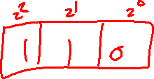
Another Way to Look at This
7²
7¹
7⁰
10²
10¹
10⁰
5
2
4
2
6
3

Slide 20
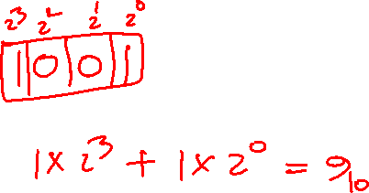
Binary Numbers (Base 2)
1001₂ = ?

Slide 21
Binary Numbers (Base 2)
base
power
most significant bit
least significant bit

Slide 22
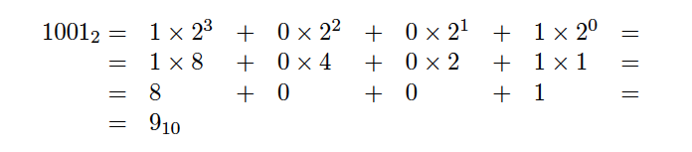
Binary Numbers (Base 2)

Slide 23
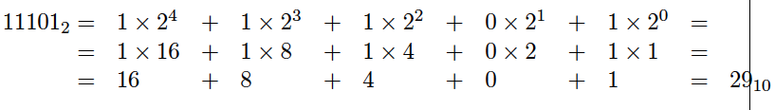
Another Example

Slide 24
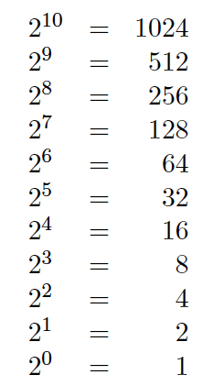
Powers of 2

Slide 25
Lec 2: Test Q1

Slide 26
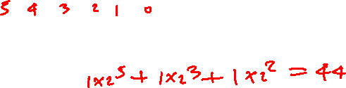
What is the value of this binary number?
0 0 1 0 1 1 0 0₂ = ?
0 0 1 0 1 1 0 0
= 0*2⁷ + 0*2⁶ + 1*2⁵ + 0*2⁴ + 1*2³ + 1*2² + 0*2¹ + 0*2⁰
= 0*128 + 0*64 + 1*32 + 0*16 + 1*8 + 1*4 + 0*2 + 0*1
= 0*128 + 0*64 + 1*32 + 0*16 + 1*8 + 1*4 + 0*2 + 0*1
= 32+ 8 + 4 = 44 (in decimal)

Slide 27
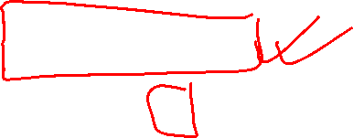
Another Way to Look at This
2⁷
2⁶
2⁵
2⁴
2³
2²
2¹
2⁰
0
0
1
0
1
1
0
0
= 1*2⁵ + 1*2³ + 1*2²
= 32+ 8 + 4 = 44 (in decimal)

Slide 28
Some Terminology
A binary digit is called a bit
A group of eight bits is called a byte
One bit can represent only two possible states, which are denoted with 1 and 0

Slide 29
Relationship Between a Byte and a Bit
1
0
1
0
1
1
1
0

Slide 30
Relationship Between a Byte and a Bit
1 bit
1
0
1
0
1
1
1
0

Slide 31
Relationship Between a Byte and a Bit
1 bit
1
0
1
0
1
1
1
0
8 bits = 1 byte

Slide 32
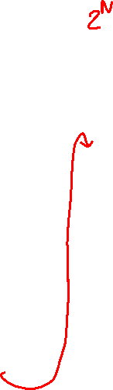
Bit Permutations
1 bit
2 bits
3 bits
4 bits
0
1
00
01
10
11
000
001
010
011
100
101
110
111
0000
0001
0010
0011
0100
0101
0110
0111
1000
1001
1010
1011
1100
1101
1110
1111
Each additional bit doubles the number of possible permutations
© 2004 Pearson Addison-Wesley. All rights reserved

Slide 33
Bit Permutations
Each permutation can represent a particular item
There are 2^{N} permutations of N bits
Therefore, N bits are needed to represent 2^{N} unique items
1 bit ?
2 bits ?
3 bits ?
4 bits ?
5 bits ?
2¹ = 2 items
How many
items can be
represented by
2² = 4 items
2³ = 8 items
2⁴ = 16 items
2⁵ = 32 items
© 2004 Pearson Addison-Wesley. All rights reserved

Slide 34

Lec 2: Test Q2
What is the maximum number that can be stored in one byte (8 bits)?

Slide 35
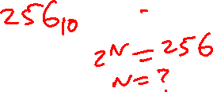
What is the maximum number that can be stored in one byte (8 bits)?
1 1 1 1 1 1 1 1
1 1 1 1 1 1 1 1
1*2⁷ + 1*2⁶ + 1*2⁵ + 1*2⁴ + 1*2³ + 1*2² + 1*2¹ + 1*2⁰
1*128 + 1*64 + 1*32 + 1*16 + 1*8 + 1*4 + 1*2 + 1*1
128 + 64 + 32 + 16 + 8 + 4 + 2 + 1 = 255 (in decimal)
Another way is: 1*2⁸ – 1 = 256 – 1 = 255

Slide 36

What would happen if we try to add 1 to the largest number that can be stored in one byte (8 bits)?
1 1 1 1 1 1 1 1
+
1
-------------------------------
1 0 0 0 0 0 0 0 0
0 0 0 0 0 0 0 0

Slide 37
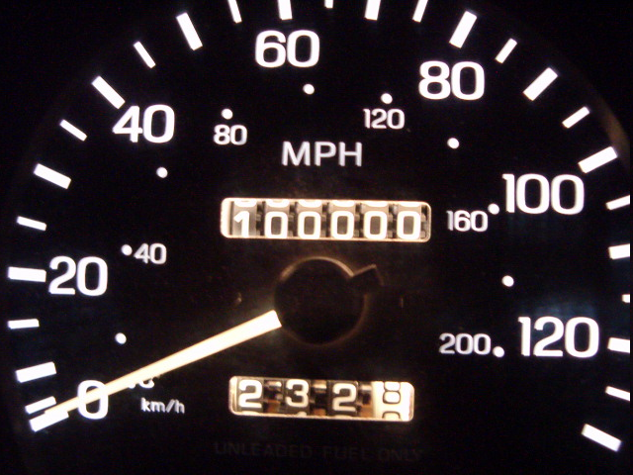

Analogy with car odometers

Slide 38
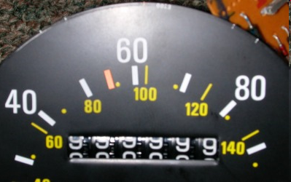
Analogy with car odometers
[http://www.hyperocity.com/volvo240/images/Volvo/odometerrepair/speedo999999.jpg]

Slide 39
Number Conversion

Slide 40
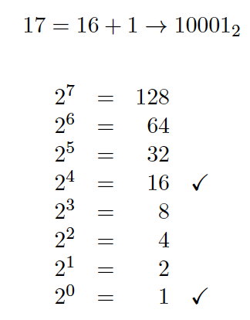
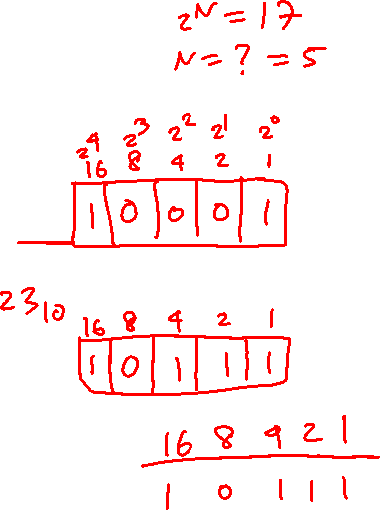
Decimal to Binary Conversion
(Using Guessing)

Slide 41
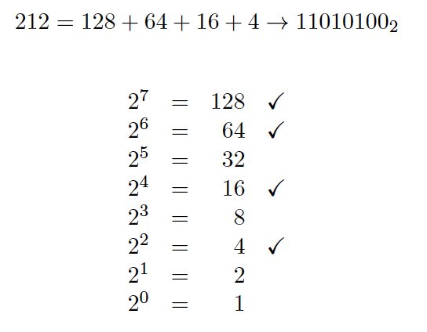
Decimal to Binary Conversion
(Using Guessing)

Slide 42
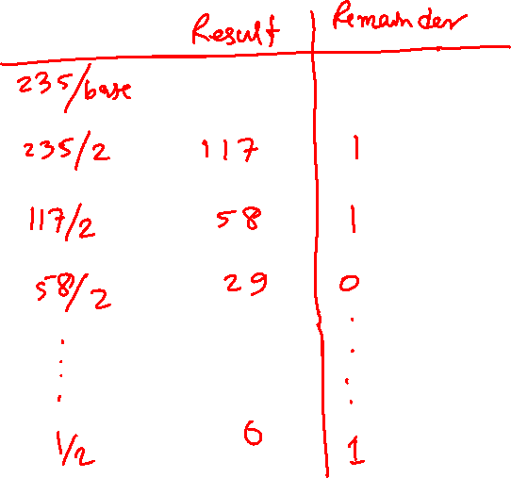
Converting from Decimal to Binary
235₁₀ = ?

Slide 43
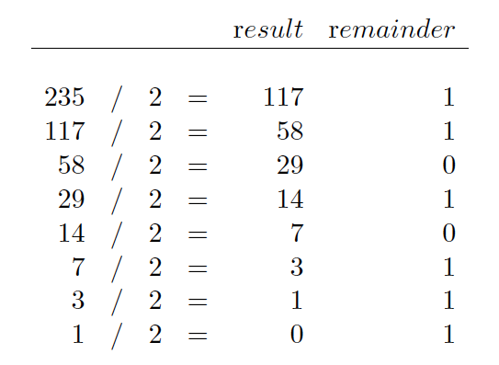
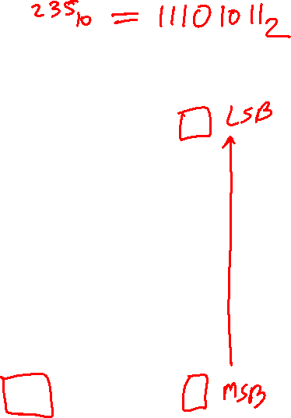
Converting from Decimal to Binary

Slide 44

Converting from Decimal to Binary

Slide 45
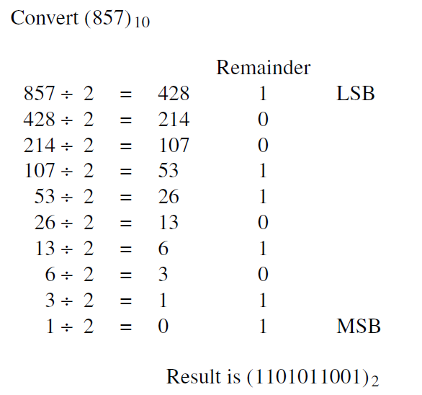
Result
[ Figure 1.6 in the textbook ]

Slide 46
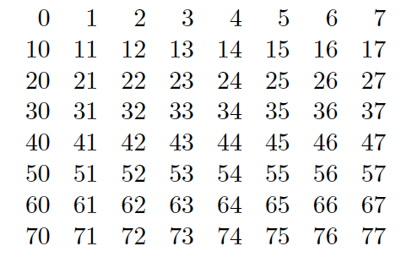

Octal System (Base 8)
0 1 2 3 4 5 6 7

Slide 47
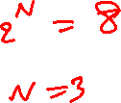
Binary to Octal Conversion
How many bits do you need to represents an Octal number?

Slide 48
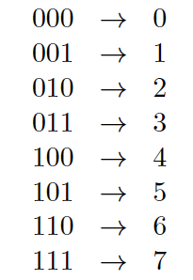
Binary to Octal Conversion

Slide 49
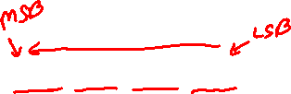
Binary to Octal Conversion
101110010111₂ = ?₈

Slide 50
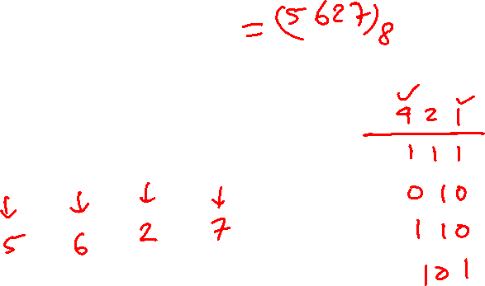
Binary to Octal Conversion
101110010111₂ = ?₈
101 110 010 111

Slide 51
Binary to Octal Conversion
101110010111₂ = ?₈
101 110 010 111

Slide 52
Binary to Octal Conversion
101110010111₂ = ?₈
101 110 010 111
5 6 2 7

Slide 53
Binary to Octal Conversion
101110010111₂ = ?₈
101 110 010 111
5 6 2 7
Thus, 101110010111₂ = 5627₈

Slide 54
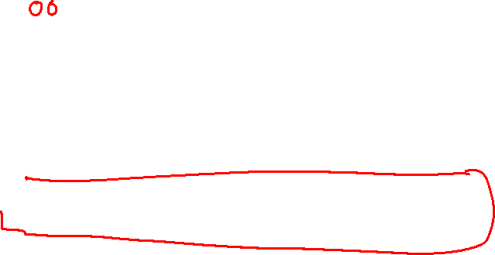
Binary to Octal Conversion
1101110010111₂ = ?₈
1 101 110 010 111
1 5 6 2 7
Thus, 1101110010111₂ = 15627₈

Slide 55
The 16 Hexadecimal Digits
0, 1, 2, 3, 4, 5, 6, 7, 8, 9,
A, B, C, D, E, F

Slide 56
The 16 Hexadecimal Digits
0, 1, 2, 3, 4, 5, 6, 7, 8, 9, A, B, C, D, E, F
10, 11, 12, 13, 14, 15

Slide 57
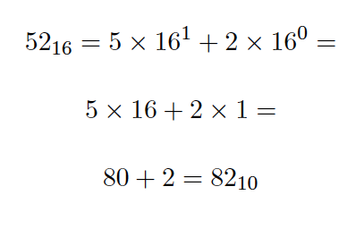
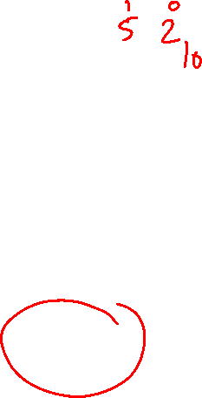
Hexadecimal System (Base 16)

Slide 58




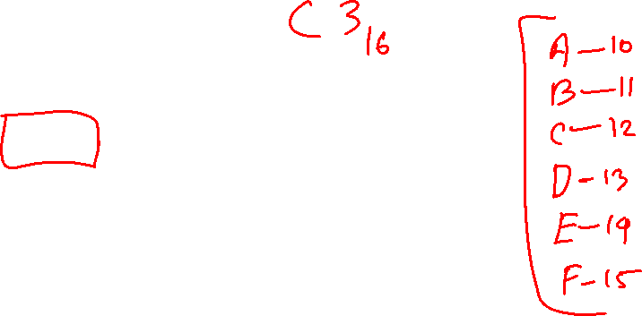
Hexadecimal to Decimal Conversion

Slide 59

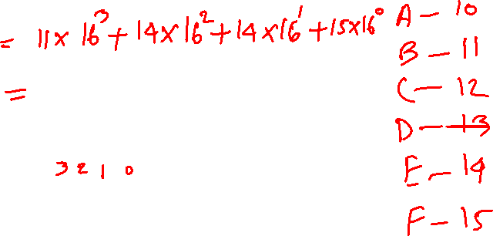
Hexadecimal to Decimal Conversion

Slide 60
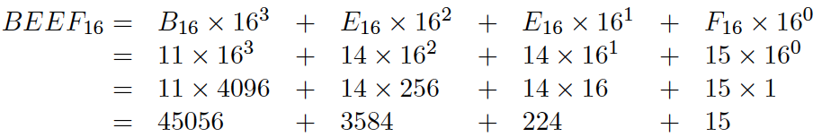

Hexadecimal to Decimal Conversion

Slide 61
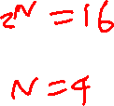
Binary to Hexadecimal Conversion
How many bits do you need to represents a Hexadecimal number?

Slide 62
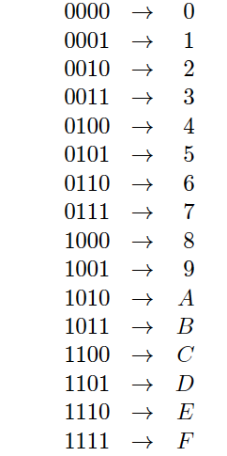
Binary to Hexadecimal Conversion

Slide 63
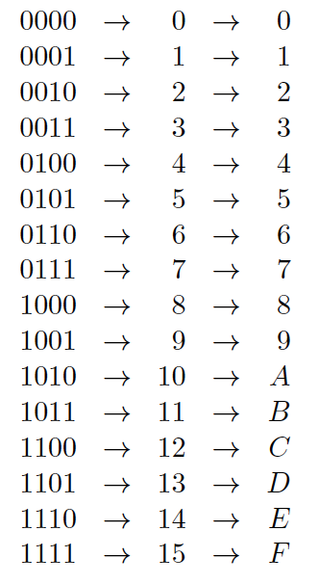

Binary to Hexadecimal Conversion

Slide 64
Binary to Hexadecimal Conversion
101110010111₂ = ?₁₆

Slide 65
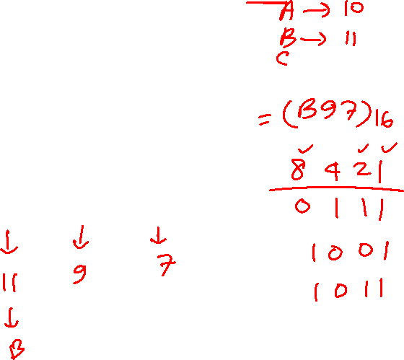
Binary to Hexadecimal Conversion
101110010111₂ = ?₁₆
1011 1001 0111

Slide 66
Binary to Hexadecimal Conversion
101110010111₂ = ?₁₆
1011 1001 0111

Slide 67
Binary to Hexadecimal Conversion
101110010111₂ = ?₁₆
1011 1001 0111
B 9 7

Slide 68

Binary to Hexadecimal Conversion
101110010111₂ = ?₁₆
1011 1001 0111
B 9 7
Thus, 101110010111₂ = B97₁₆

Slide 69
Binary to Hexadecimal Conversion
1101110010111₂ = ?₁₆
1 1011 1001 0111
1 B 9 7
Thus, 1101110010111₂ = 1B97₁₆

Slide 70
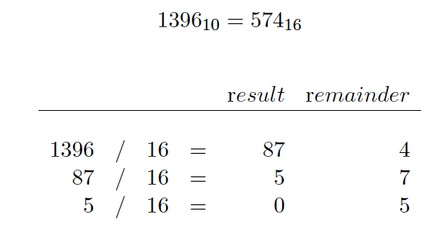
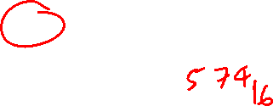
Decimal to Hexadecimal Conversion

Slide 71
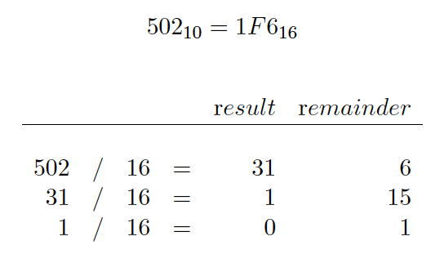
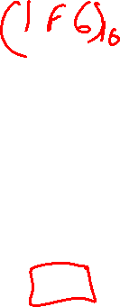
Decimal to Hexadecimal Conversion

Slide 72
Lec 2: Test Q3

Slide 73
Signed integers are more complicated
We will talk more about them when we start with Chapter 3 in a couple of weeks.

Slide 74
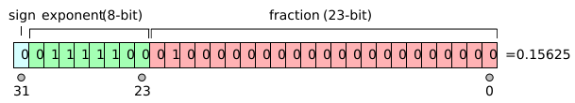
The story with floats is even more complicated
IEEE 754-1985 Standard
[http://en.wikipedia.org/wiki/IEEE_754]

Slide 75
In the example shown above, the sign is zero so s is +1, the exponent is 124 so e is −3, and the significand m is 1.01 (in binary, which is 1.25 in decimal). The represented number is therefore +1.25 × 2⁻³, which is +0.15625.
[http://en.wikipedia.org/wiki/IEEE_754]

Slide 76
On-line IEEE 754 Converter
http://www.h-schmidt.net/FloatApplet/IEEE754.html
More about floating point numbers in Chapter 3.

Slide 77
Storing Characters
This requires some convention that maps binary numbers to characters.
ASCII table
Unicode

Slide 78
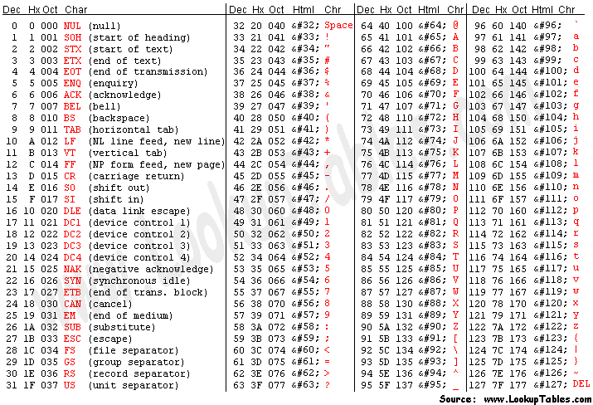
ASCII Table

Slide 79
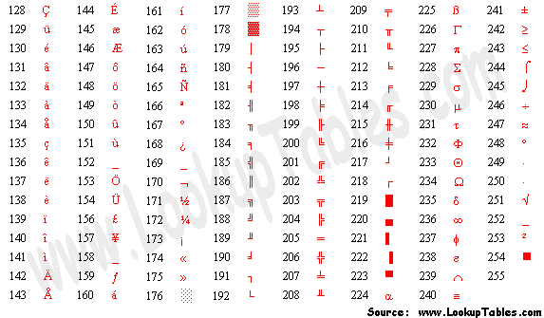
Extended ASCII Codes

Slide 80
The Unicode Character Code
http://www.unicode.org/charts/

Slide 81
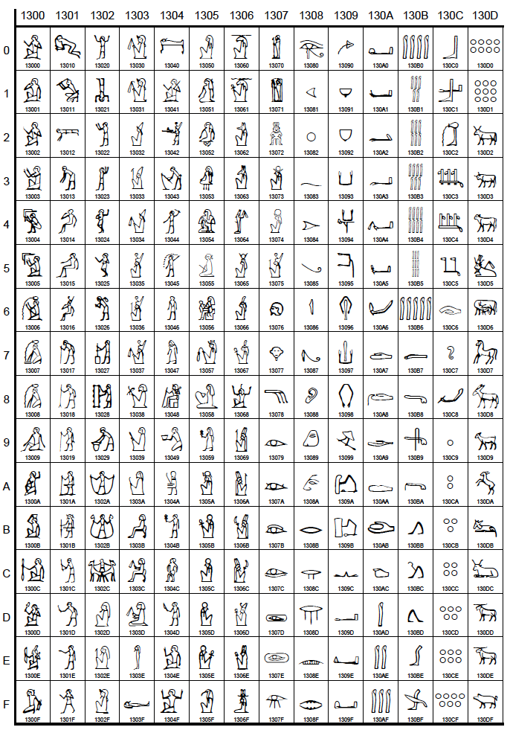
Egyptian
Hieroglyphs
http://www.unicode.org/charts/

Slide 82
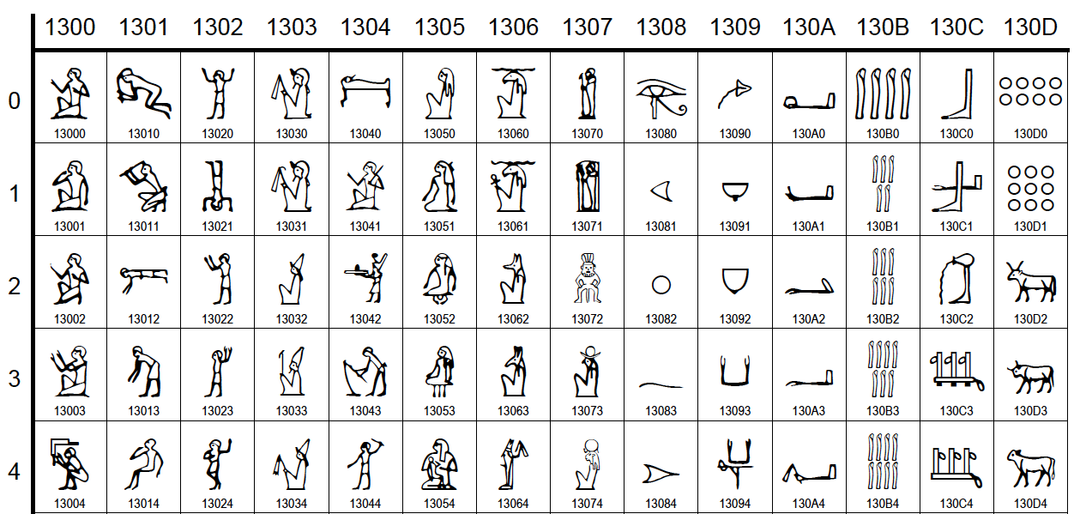
Close up
http://www.unicode.org/charts/

Slide 83

END Slide

